Slide 1

Highlights for regression problems

Slide 2
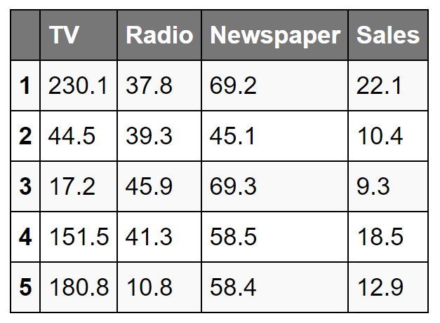
Data

Slide 3
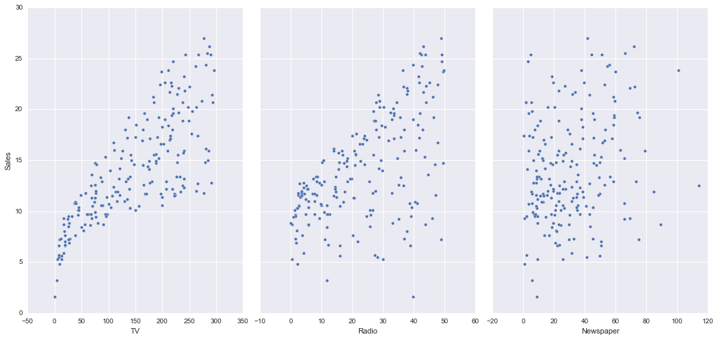
Data Exploration - outlier

Slide 4
Feature Engineering
Log / Squared scaling to get linear connection
merge features by + / * -

Slide 5
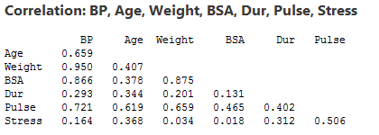
Detecting collinearity
Correlation matrix

Slide 6
Transforming features to fit non-linear relationships

Slide 7
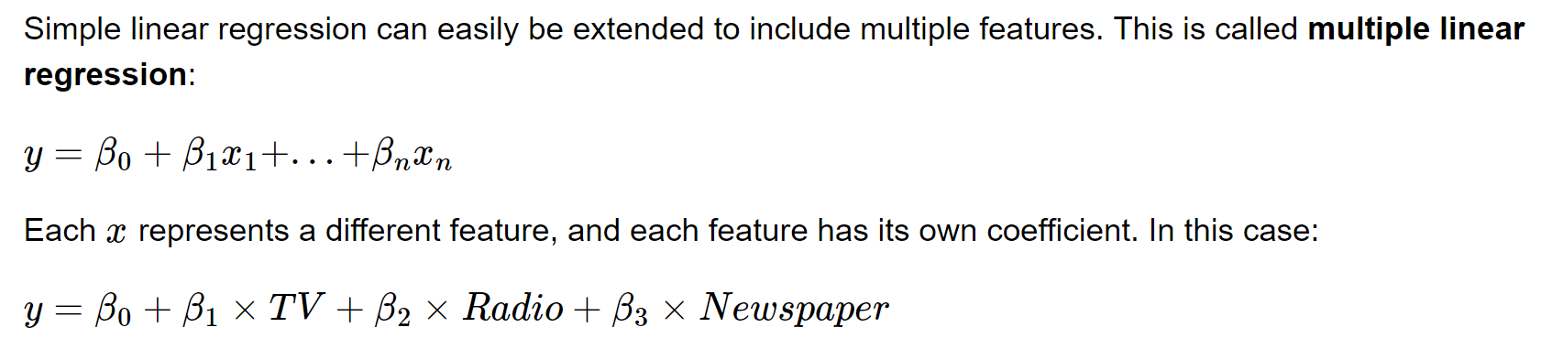
Diagnosing model fit

Slide 8
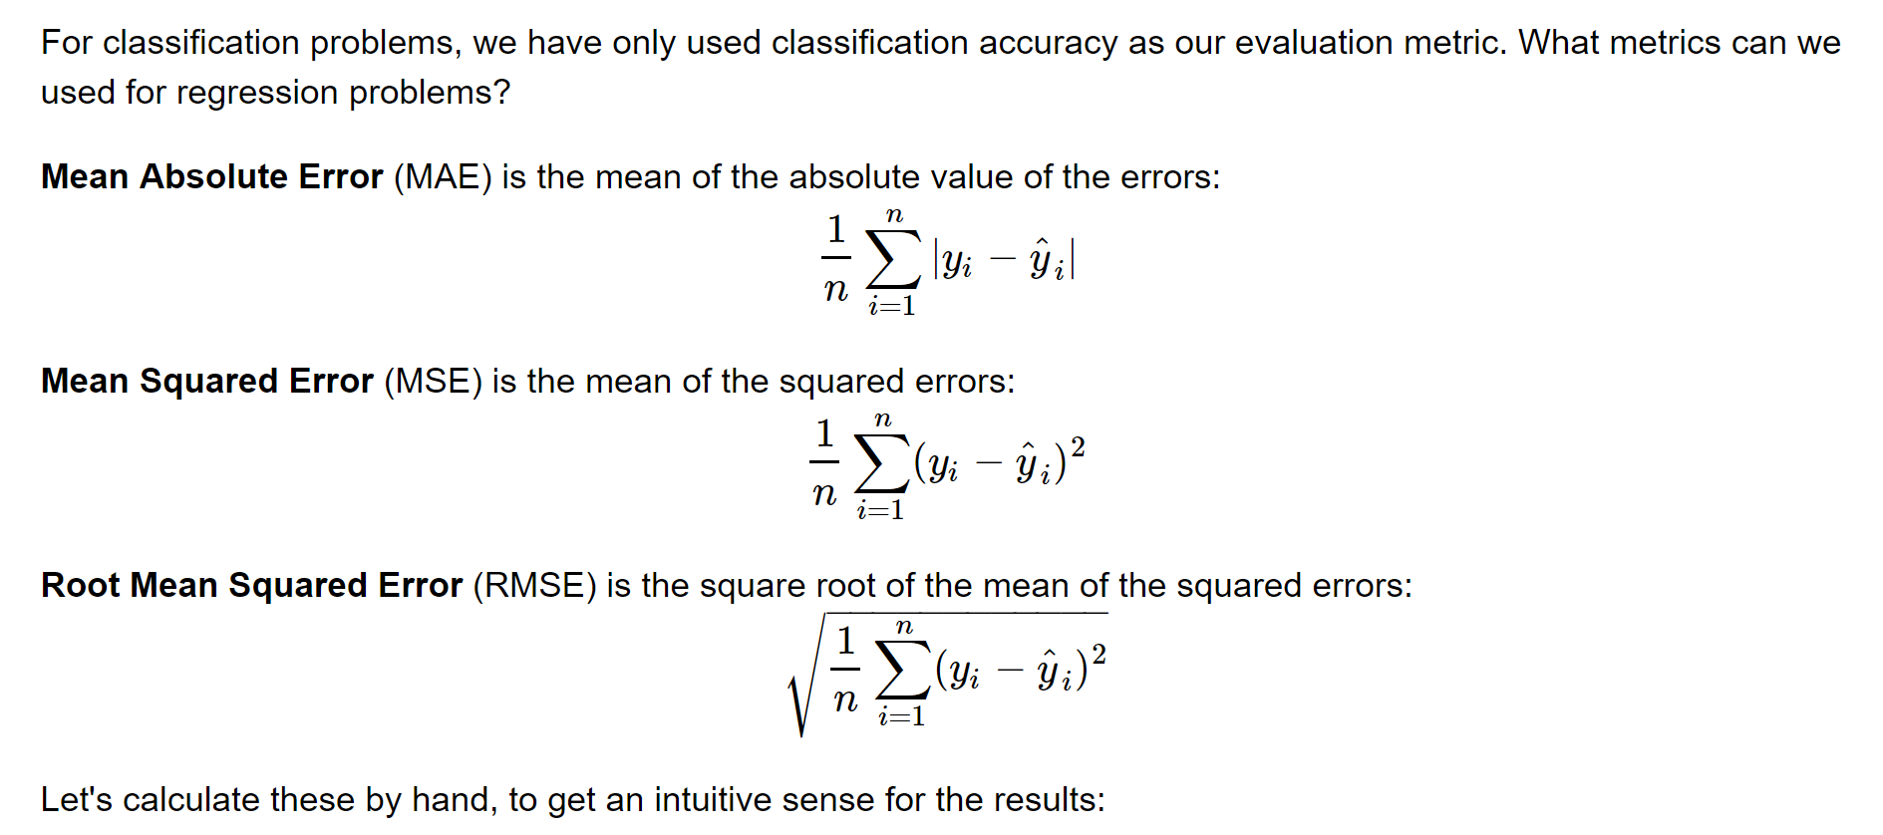
Model Evaluation Metrics for Regression

Slide 9
sources
https://www.ritchieng.com/machine-learning-evaluate-linear-regression-model/

